Slide 2
LITTLE DUCKS
2ND Hello to all the Little Ducks and Friends

Slide 4
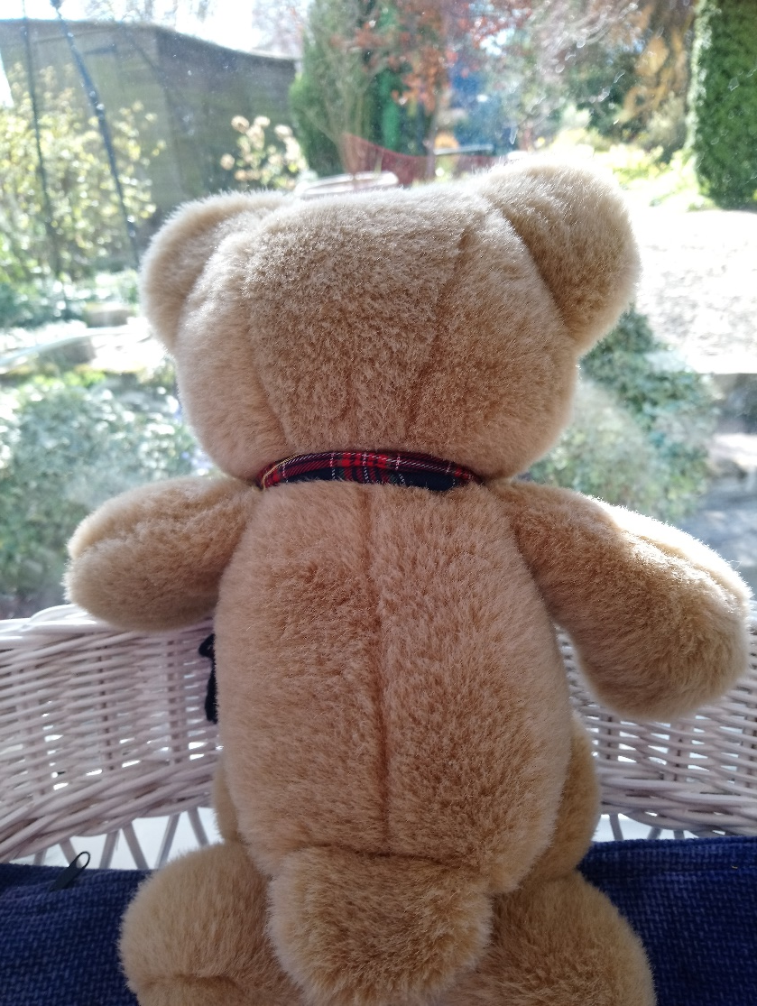
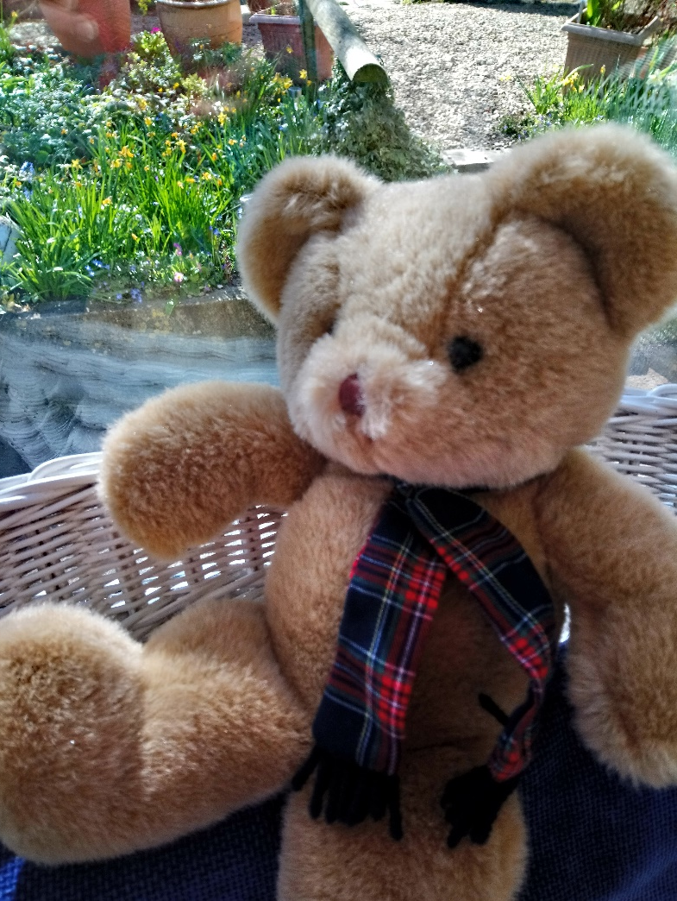
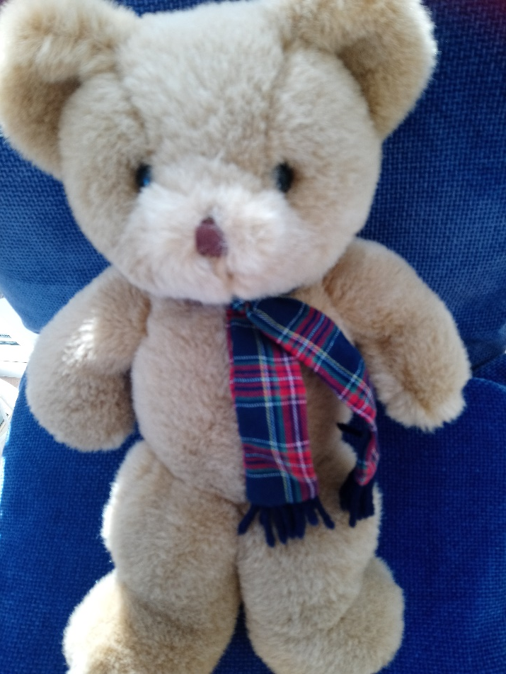
Little Bear is being very good and staying at home. He is enjoying the sunshine and watching the birds and animals in the garden. But, he hasn’t seen any Little Ducks.

Slide 5
Copy the link and paste into your search engine watch the video from Little Bear.
https://vimeo.com/405795012

Slide 6
LITTLE DUCKS
Good bye for now.
Follow the instructions to stay at home and stay safe.
Little Ducks and Friends, be kind, be polite and enjoy the Weird and the Wonderful.

Slide 8
Thank you to all the Little Ducks and Friends who sent things to share and who gave technical help.
A Big, Little Duck Flap!

Slide 9
Little Bear will be back.

