Slide 1
Teach reading: change lives
Parent workshop: Phonics and early reading
Notes:
Our new scheme has come about because back in July 2021, the government released a paper called ‘The Reading Framework’. Within this document it set out core principles for teaching children to read in EYFS and Year 1 and for older children who hadn’t yet mastered the foundations. It states that every child will be able to read proficiently whilst developing a genuine love of reading. As a school, we chose to follow a new Systematic Synthetic Programme (SSP) as fidelity to one scheme runs heavily throughout this document.

Slide 2
A love of reading is the biggest indicator of future academic success.
OECD (The Organisation for Economic Co-operation and Development)
Notes:
As we have leant over the last few months Little Wandle love a quote so we thought we would start with one. Here it is ‘A love of reading is the biggest indicator of future academic success.’ Here at Malmesbury C of E Primary school we want to create a long love of reading.

Slide 3


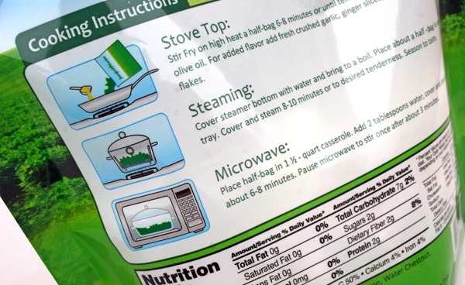
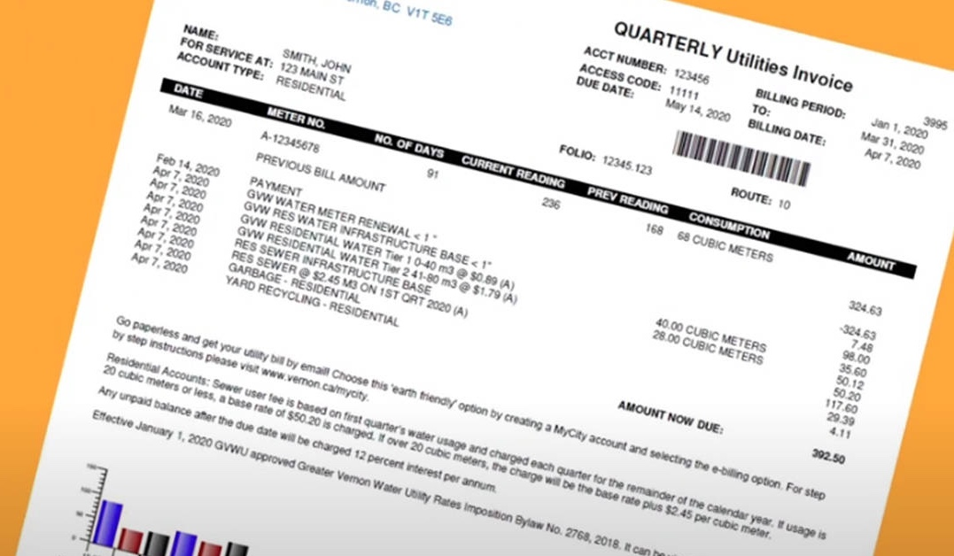
How many times have you already read today?
Notes:
We just want you to pause for a second and think about how many times you have already read today.
As you can see reading really is a vital skill and we use it all the time, it is fundamental.
Which is why at Malmesbury Primary School we have invested huge amounts of money and time to ensure we get this right. We have invested in brand new books which you are seeing brought home on a Friday and consistent resources in each classroom and what you don’t see, time, our first TD day this year was all devoted to training for everyone in the school for this scheme.

Slide 4

Phonics

Slide 5

Little Wandle Letters and Sounds Revised
Our school has chosen
Little Wandle Letters and Sounds Revised as our systematic, synthetic phonics (SSP) programme to teach early reading and spelling.
Notes:
Our school has chosen Little Wandle Letters and Sounds Revised as our systematic, synthetic phonics (SSP) programme to teach early reading and spelling.

Slide 6
Phonics is:
making connections between the sounds of our spoken words and the letters that are used to write them down.
Notes:
So what is Phonics? Phonics is making connections between the sounds of our spoken words and the letters that are used to represent/written down. It sounds complicated but it really isn’t!

Slide 7

Blending to read words
Notes:
Some children learn to blend really quickly, and others take a little longer. If your child is finding it difficult, ask your child’s teacher for ways to help at home – playing blending games at home is so helpful! If your child is taking a little longer their class teacher will identify this and start keep up sessions to help keep them on track.
Click on the link and watch the video ‘Blending to read words. https://www.littlewandlelettersandsounds.org.uk/resources/for-parents/

Slide 8
Terminology
Phoneme
Split vowel digraph
Grapheme
Blend
Digraph
Segment
Trigraph
Notes:
Phoneme -The smallest unit of sound that can be identified in words. We sometimes simply call this a ‘sound’, although it is helpful for children to use the term ‘phoneme’ from the beginning of our programme.
Grapheme- A letter or group of letters used to represent a particular phoneme when writing. With children, we sometimes call this ‘a sound written down’, although, as with ‘phoneme’, it is helpful for children to learn to use the correct term from the beginning. The way graphemes are used to represent phonemes in our written language is known as the ‘alphabetic code’.
Digraph- A grapheme using two letters to represent one phoneme. With children, we frequently reinforce it with the mantra ‘two letters, one sound’. At the appropriate stage, it is useful for children to learn to use the term and to understand what it means. For example s and h make a the ‘sh’ phoneme.
Trigraph- A grapheme using three letters to represent one phoneme. With children, we frequently reinforce it with the mantra ‘three letters, one sound’. At the appropriate stage, it is useful for children to learn to use the term and to understand what it means.
Split vowel digraph - A digraph representing a vowel sound where the two letters are split by an intervening consonant (for example, ‘a_e’ in ‘take’). Despite having a consonant in between them, the two letters involved (here ‘a’ and ‘e’) still count as one digraph, making one sound. The vowel sound is pronounced at the position of the first of the two letters of the digraph (that is, in the middle of ‘take’). At early learning stages, a split digraph is often highlighted with a short line joining the two halves of the digraph above the intervening consonant.
Blend- To combine individual phonemes into a whole word, working all the way through from left to right. Once the GPCs involved have been learned, blending is the key process involved in reading words effectively. It is a skill that needs extensive practice. Practice in oral blending is very helpful, both before and during the process of learning to read. It is important to understand that blending sounds into a word is not simply a matter of saying them more quickly, nor of mixing them together like paint. Phonemes need to be joined into one continuous stream of sound to make a spoken word. Extensive practice, following teacher modelling, is the key.
Segment- To identify each of the individual phonemes in a word, working all the way through from left to right. This is an important first stage of writing (spelling) a word but needs to be practised orally first. Counting the phonemes is often helpful in reinforcing this process.

Slide 9


Teaching order
Notes:
We usually teach four new sounds a week and have a review lesson on a Friday. You will get a list of the sounds that we are learning to have at home. This will help you with formation and pronunciation.

Slide 10
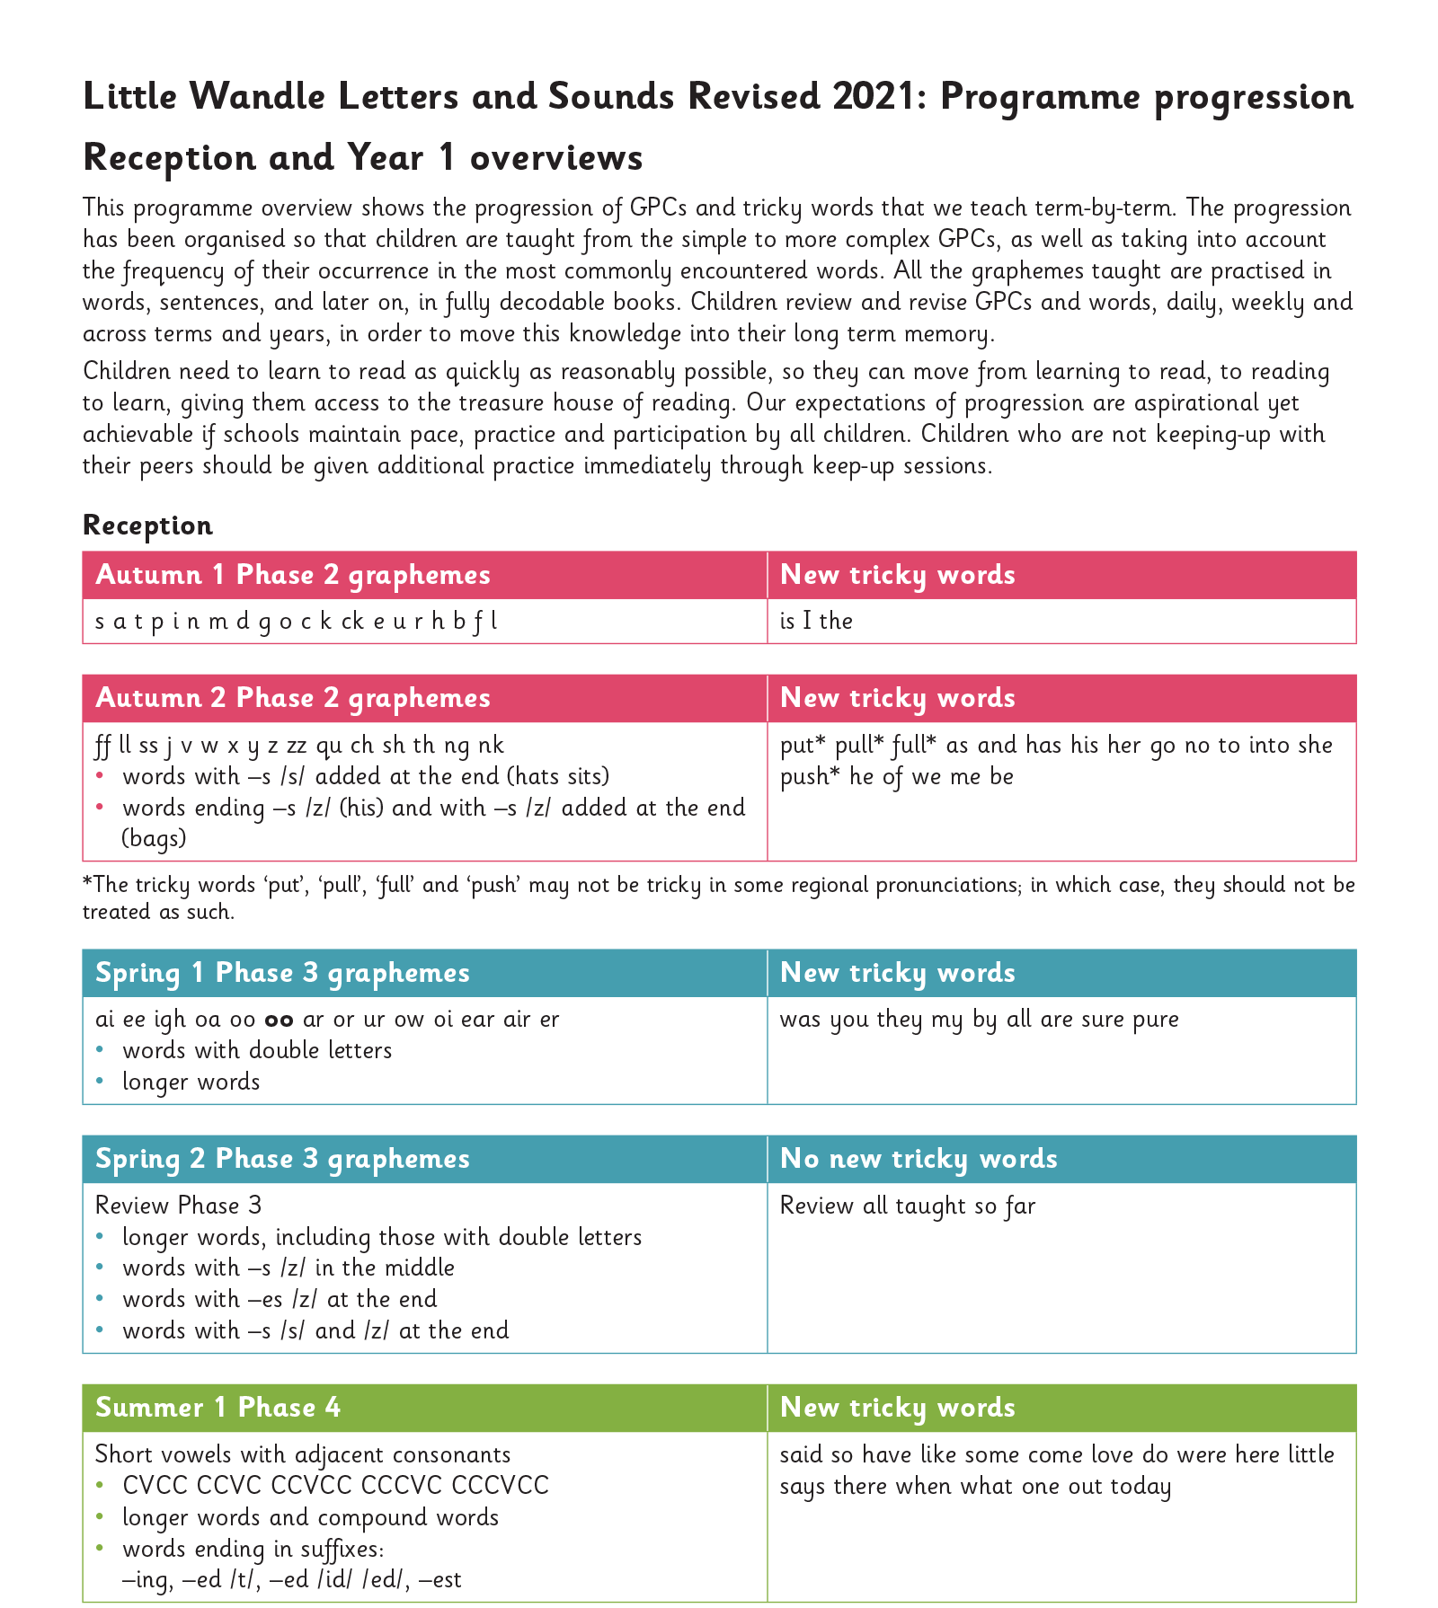
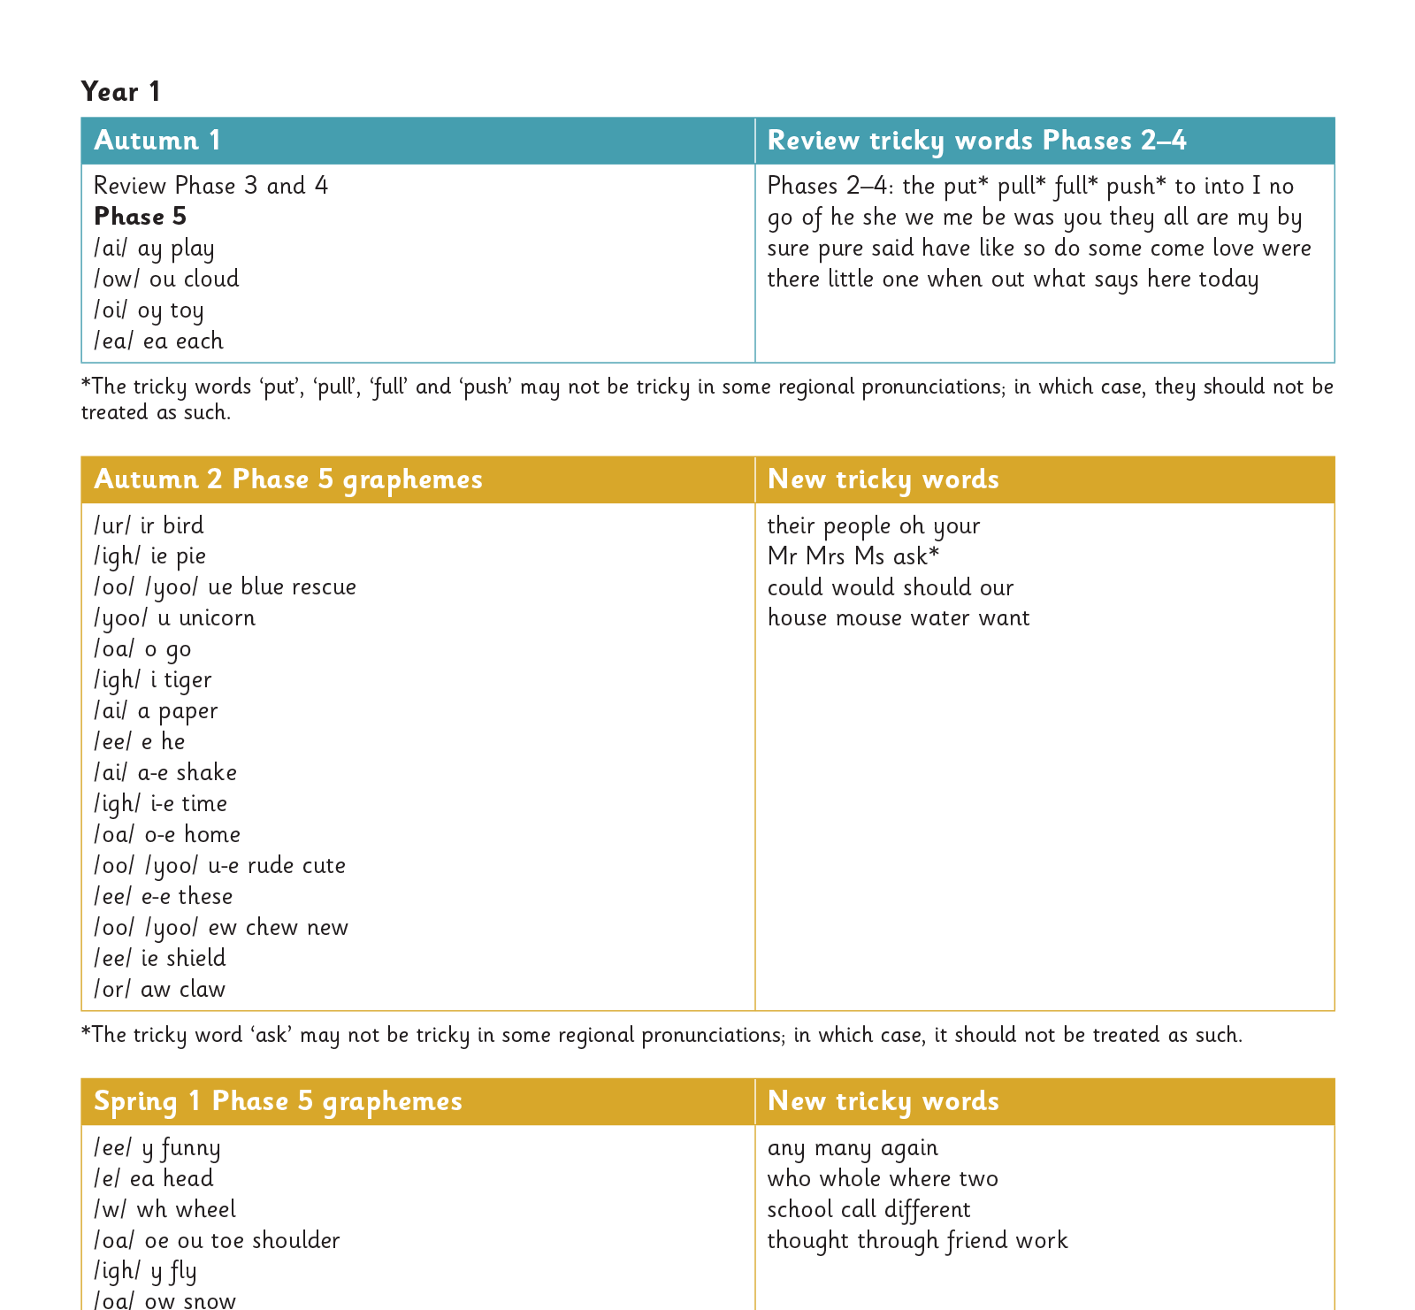
Gradually your child learns the entire alphabetic code:
Notes:
We will work our way through the whole Little Wandle Programme until your child can read fluently. We knew at the end of last year we were introducing LW, so we completed placement quizzes with all the children which showed us gaps. This is because this new scheme goes further than we had to teach previously. So this year, Year 1 and 2 went back to consolidating gaps and refreshing the children from the summer holidays. Usually in year 2, we would use the Autumn term to consolidate to ensure confidence in reading and spelling within their writing. This allows for a smoother transition from Year 1 to year 2. Once we have completed LW, we move onto Year 2 Spelling patterns as set out by the national curriculum. Those who haven’t completed LW with still continue to be supported through ‘Catch Up’ sessions.

Slide 11
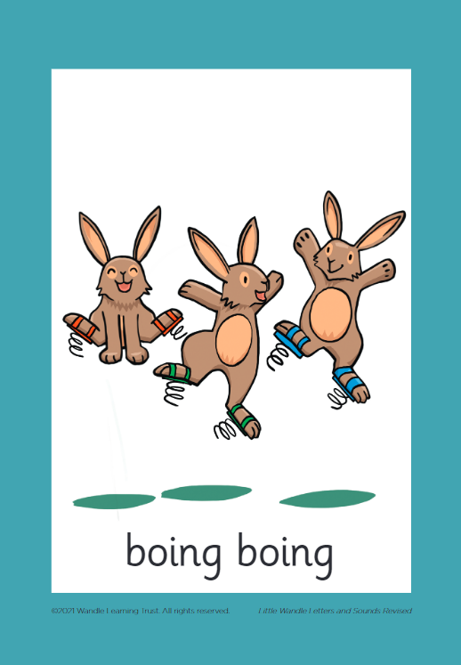
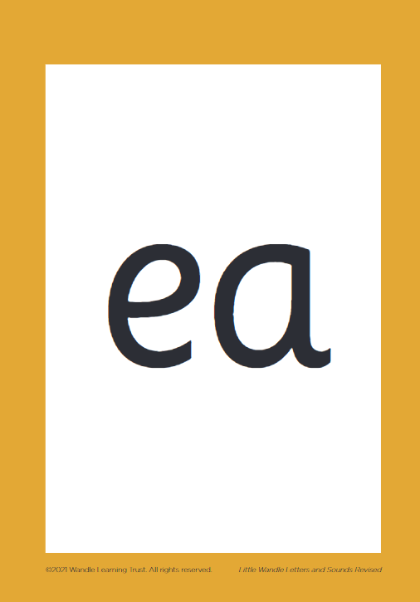
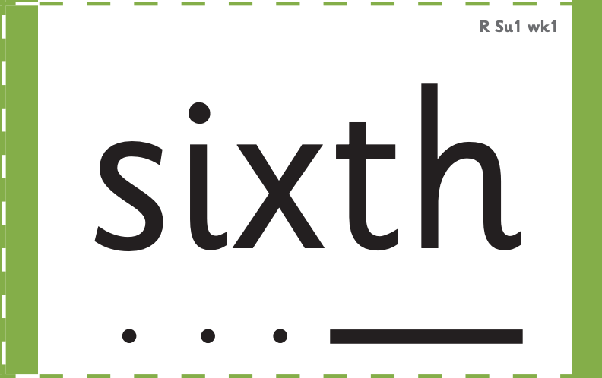

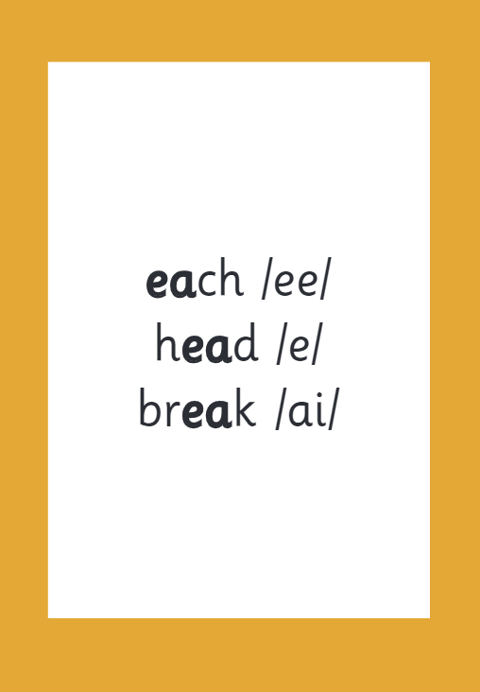

How we make learning stick
Notes:
There are specific resources for the Little Wandle Programme which the children will be very familiar with. Each sound that we teach to begin with has either a mnemonic (like the astronaut that you can see here) or a phrase like boing-boing for ‘oi’. This helps the children recognise and remember the graphemes. Every time we teach a new sound, we also read words during the phonics lesson that contain that new sound so that the children practise what they have learned. We then go on to reading a sentence containing some of those words. We have displays in the classroom and on the tables to support the children throughout the day.

Slide 12
Reading and spelling

Slide 13
Reading and spelling
Notes:
Here is an example of what children will be learning in year 1. Children learn that there are graphemes (the written representation for a sound) that can have different sounds and sounds that can be made with different letters.

Slide 14
And all the different ways to write the phoneme sh:
shell
chef
special
caption
mansion
passion
Notes:
On this slide you can see there are many different ways you can write the sh phoneme. Take a moment to read the words and spot the sh phonemes.

Slide 15
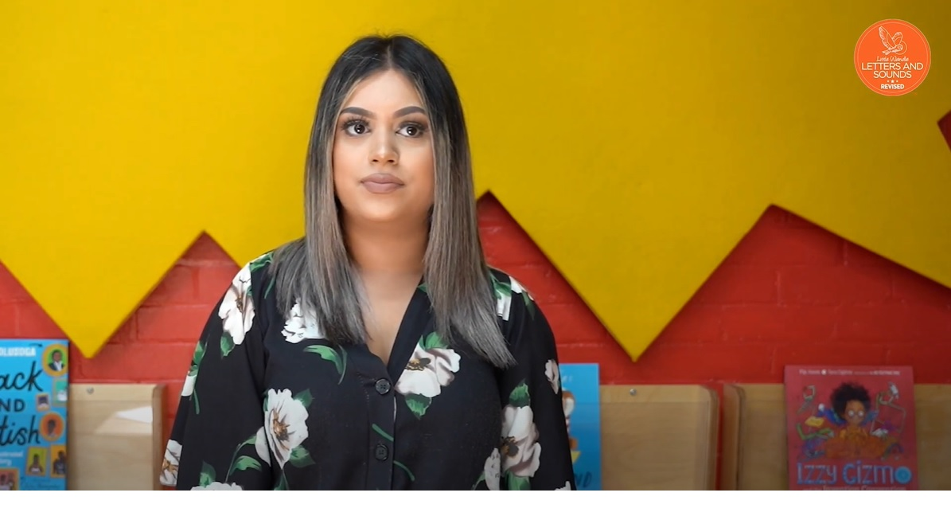
Tricky words
Notes:
Click on the link and watch the video ‘Tricky words.’ https://www.littlewandlelettersandsounds.org.uk/resources/for-parents/

Slide 16

Spelling
Say the word.
Segment the sounds.
Count the sounds.
Write them down.
Notes:
On a piece of paper try and do the above with the word zoom.

Slide 17
How do we teach reading in books?
Reading practice sessions are:
timetabled three times a week
taught by a trained teacher/teaching assistant
taught in small groups.
Notes:
Our children read the same book during the three sessions. The first session we work on decoding (sounding out) the words and looking at vocabulary within the book, the second session, we work on prosody which is reading with expression – making the book sound more interesting with our story-teller voice or our David Attenborough voice – and the third session, we look at comprehension, using different types of questioning, these are known in Year 2 as VIPERS V-vocabulary, I-inference (drawing meaning by what the author has written) P- predicting E- explaining R- retrieval and S- sequencing. We read the books three times at school because we want to develop the fluency. The more they see words the more they begin to read them automatically without having to sound them out. Reading practice takes place on a Wednesday, Thursday and Friday. Books will go home on a Friday and will need to be returned on a Monday. There is a £5 charge for damaged or lost books. Please don’t allow your child to write in the book.

Slide 18

We use assessment to match your child the right level of book
Notes:
In reception your child is assessed every six weeks to check progress. Any child who needs extra support has daily keep-up sessions planned for them. Additionally in Year 1 and 2 Teacher judgement will be used alongside assessments.

Slide 19
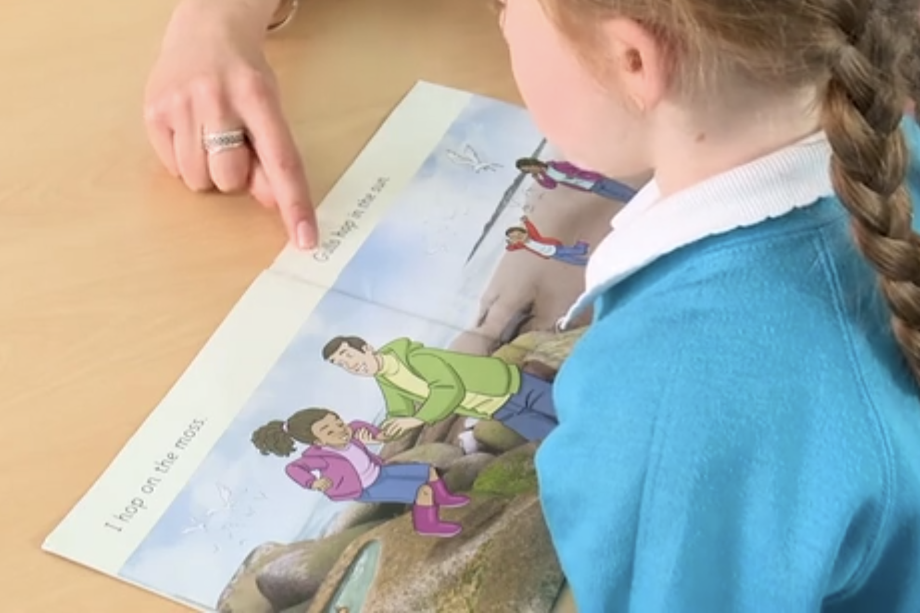
Reading a book at the right level
This means that your child should:
Know all the sounds and tricky words in their phonics book well
Read many of the words by silent blending (in their head) – their reading will be automatic
Only need to stop and sound out about 5% of the words by the time they bring the book home – but they should be able to do this on their own.
Notes:
This means that your child should:
Know all the sounds and tricky words in their phonics book well
Read many of the words by silent blending (blend in your head) – their reading will be automatic
They might only need to stop and sound out about 5% of the words by the time they bring the book home – but they should be able to do this on their own.

Slide 20
Reading at home

Slide 21
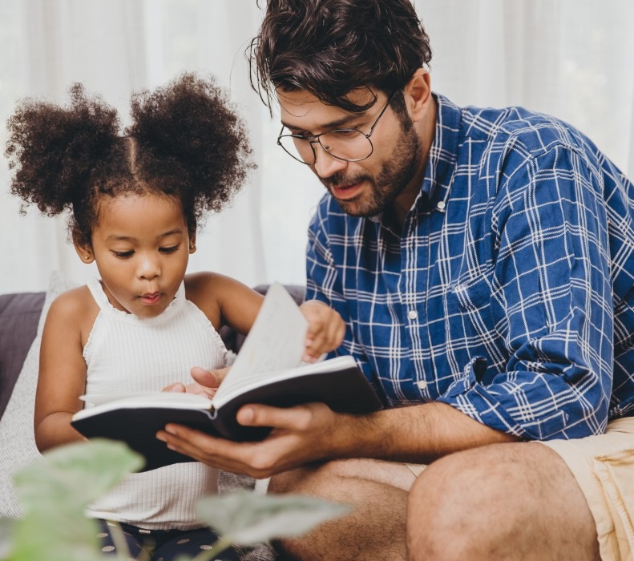
The most important thing you can do is read with your child
Reading a book and chatting has a positive impact a year later on a child’s ability to…
understand words and sentences
use a wide range of vocabulary
develop listening comprehension skills.
Parental involvement in the development of children’s reading skills: A five-year longitudinal study (2002) Senechal, M. and Lefvre, J
Notes:
Reading a book and chatting has a positive impact a year later on a child’s ability to…
understand words and sentences
use a wide range of vocabulary
develop listening comprehension skills.

Slide 22



Books going home
Notes:
As well as the ‘’Reading Practice’ book that your child will bring home they will also bring home a book for sharing with you. This book is SO important. This is how we are going to give them the WILL to read. Please read with your child as often as you can – at least once a day if possible. Library is once a week and on a Thursday.

Slide 23
Listening to your child read their phonics book
Your child should be able to read their book without your help.
If they can’t read a word read it to them.
Talk about the book and celebrate their success.
Notes:
Your child should be able to read their book without your help.
If they can’t read a word read it to them.
Talk about the book and celebrate their success.

Slide 24
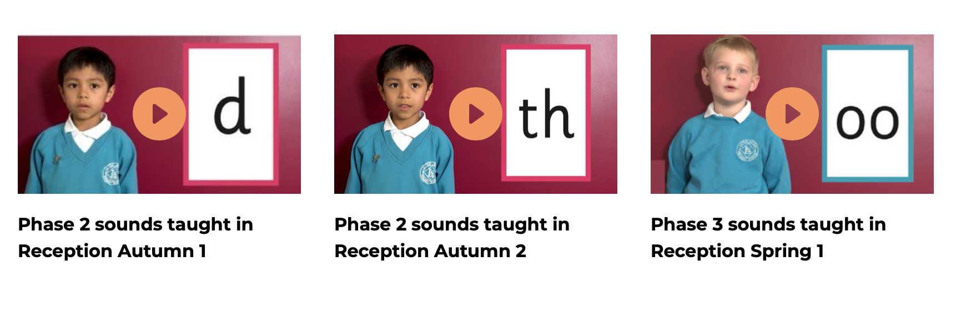
Supporting your child with phonics
Notes:
It is really important that you pronounce the sounds correctly at home if you are supporting your child. These videos are on the website for you to refer to and if you are unsure, please ask your child’s teacher.
Please go to the following link to hear the correct pronunciation.
https://www.littlewandlelettersandsounds.org.uk/resources/for-parents/

Slide 25

Read to your child
The shared book is for YOU to read:
Make the story sound as exciting as you can by changing your voice.
Talk with your child as much as you can:
  Introduce new and exciting language
  Encourage your child to use new vocabulary
  Make up sentences together
  Find different words to use
  Describe things you see.
Notes:
The shared book is for YOU to read:
Make the story sound as exciting as you can by changing your voice.
Talk with your child as much as you can:
Introduce new and exciting language
Encourage your child to use new vocabulary
Make up sentences together
Find different words to use
Describe things you see.

Slide 26
One of the greatest gifts adults can give is to read to children
Carl Sagan
Notes:
So as we said at the beginning Little Wandle love a quote so here’s one to end. ‘One of the greatest gifts adults can give is to read to children’
Carl Sagan.

Slide 27
Any Questions?

